Slide 1
b0010 Boolean Logic
ENGR xD52
Eric VanWyk
Fall 2012

Slide 2
Acknowledgements
Mark L. Chang lecture notes for Computer Architecture (Olin ENGR3410)
Patterson & Hennessy: Book & Lecture Notes
Patterson’s 1997 course notes (U.C. Berkeley CS 152, 1997)
Tom Fountain 2000 course notes (Stanford EE182)
Michael Wahl 2000 lecture notes (U. of Siegen CS 3339)
Ben Dugan 2001 lecture notes (UW-CSE 378)
Professor Scott Hauck lecture notes (UW EE 471)
Mark L. Chang lecture notes for Digital Logic (NWU B01)

Slide 3
Today:
Review Feedback from last class
Review HW0
Finish Boolean Logic

Slide 4
Most Favoritest Processors
“whatever I have in my laptop”
Second was “what?”
Apple A4 – ARM Cortex A8 w/ PowerVR GPU
ARM
Snapdragon / Tegra
Atmega / AVR
AEMB
GPU
The Babbage Engine(s)
Microsoft Word/Food Processor

Slide 5
I want to learn:
Why NAND/NOR is ‘universal’
How math happens
How memory is organized, stored, accessed
Assembly / How C becomes Assembly
Data busses, setup / hold times, clocking
How GPUs process triangles
History of Comp Arch
What up with Raspberry Pi?
Verilog / FPGAs
Multi-threading
Peripherals
Fix the K’nex’ulator
Build a computer in Minecraft

Slide 6
Basic Logic Gates

Slide 7
Basic Logic Gates
AND
NAND
OR
NOR
XOR
(exclusive or)
XNOR
NOT

Slide 8
Boolean Equations
AND: AB A&B
OR: A+B
NOT: A̅ ~A

Slide 9
Basic Boolean Identities:
X + 0 = X * 1 =
X + 1 = X * 0 =
X + X = X * X =
X + X̅ = X * X̅ =
X̅ =

Slide 10
Basic Laws
Commutative Law:
X + Y = Y + X XY = YX
Associative Law:
X+(Y+Z) = (X+Y)+Z X(YZ)=(XY)Z
Distributive Law:
X(Y+Z) = XY + XZ X+YZ = (X+Y)(X+Z)

Slide 11
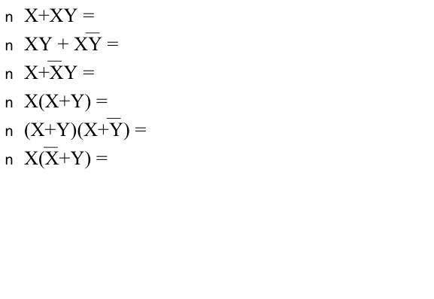
Advanced Laws

Slide 12
Karnaugh Map Review
Moving one square changes only one input.
Cover all 1s with boxes.
Boxes must be power of 2 sized.
Create Sum of Products
Boxes can “wrap around” the edges of the map.
Toroidal mapping

Slide 13
Karnaugh Map Review
 | AB | A̅B | A̅B̅ | AB̅
CD | ABCD | A̅BCD | A̅B̅CD | AB̅CD
C̅D | ABC̅D | A̅BC̅D | A̅B̅C̅D | AB̅C̅D
C̅D̅ | ABC̅D̅ | A̅BC̅D̅ | A̅B̅C̅D̅ | AB̅C̅D̅
CD̅ | ABCD̅ | A̅BCD̅ | A̅B̅CD̅ | AB̅CD̅

Slide 14
Karnaugh Map Review
 | AB | A̅B | A̅B̅ | AB̅
CD | ABCD | A̅BCD | A̅B̅CD | AB̅CD
C̅D | ABC̅D | A̅BC̅D | A̅B̅C̅D | AB̅C̅D
C̅D̅ | ABC̅D̅ | A̅BC̅D̅ | A̅B̅C̅D̅ | AB̅C̅D̅
CD̅ | ABCD̅ | A̅BCD̅ | A̅B̅CD̅ | AB̅CD̅
Which “advanced” law allows us to combine boxes?

Slide 15
Why Karnaugh?
“Mechanical” method guaranteed to get something that works.
Result is only two layers deep – Fast!

Slide 16
Why not Karnaugh?
Confusing visually for more than 4 variables
But it still works if you squint
Optimizes for speed, not space.

Slide 17
To the Boards!
F = (X+Y̅+XY̅)(XY+X̅Z+YZ)
Evaluate Truth Table
Pro Tip: Build in Layers
Simplify with Karnaugh
Simplify with Boolean Law

Slide 18
DeMorgan’s Law
X
Y
X
Y
X
+
Y
X•Y
0
0
1
1
(X + Y) = X * Y
0
1
1
0
1
0
0
1
1
1
0
0
(X * Y) = X + Y
X
Y
X
Y
X•Y
X
+
Y
0
0
1
1
0
1
1
0
1
0
0
1
1
1
0
0
Example:
Z = A B C + A B C + A B C + A B C
Z = (A + B + C) * (A + B + C) * (A + B + C) * (A + B + C)

Slide 19
DeMorgan’s Law example

Slide 20
The Universal Gates
Karnaugh maps can frame any boolean equation in sum of products (OR of ANDs)
DeMorgan can frame any AND/OR in NAND/NORs
NAND and NOR can represent any combinatorial boolean equation.

Slide 21
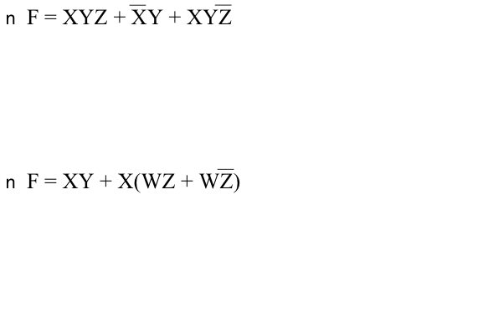
Boolean Equations to Circuit Diagrams

