Slide 1
b1010 Advanced Math Stuff
ENGR xD52
Eric VanWyk
Fall 2012

Slide 2
Acknowledgements
Ray Andraka: A survey of CORDIC algorithms for FPGA based computers
Lumilogic
Jack E. Volder, The CORDIC Trigonometric Computing Technique

Slide 3
Today
Review Recursive Function Calls
Homework 3
CORDIC: Sines, Cosines, Logarithms, Oh My

Slide 4
Factorial Function
int Fact(int n){
if(n>1)
return n* Fact(n-1)
else
return 1

Slide 5
Factorial Function
int Fact(int n){
if(n>1) goto end:
return n* Fact(n-1)
end:
return 1

Slide 6
Factorial Function
$v0 Fact(int n){
if(n>1) goto end:
$v0 =n* Fact(n-1)
jr $ra
end:
$v0 = 1
jr $ra

Slide 7
Factorial Function
$v0 Fact ($a0)
ble $a0, 1, end:
$v0 =n* Fact(n-1)
jr $ra
end:
$v0 = 1
jr $ra
We have most of what we need:
Goto flow control for if
jr $ra for return
Registers assigned
Now we need to call Fact
What do we save?
What order?
Lets focus on the call site

Slide 8
Factorial Function Call Site
To Call Fact:
Push registers I need to save
$ra
$a0
Setup Arguments
N-1: $a0 = $a0-1
Jump and Link Fact:
Restore registers

Slide 9
Factorial Function Call Site
sub $sp, $sp, 8
sw $ra, 4($sp)
sw $a0, 0($sp)
sub $a0, $a0, 1
jal fact
lw $ra, 4($sp)
lw $a0, 0($sp)
add $sp, $sp, 8
To Call Fact:
Push $ra, $a0
Setup $a0
Jump and Link Fact:
Restore $ra, $a0

Slide 10
Factorial Function Call Site
sub $sp, $sp, 8
sw $ra, 4($sp)
sw $a0, 0($sp)
sub $a0, $a0, 1
jal fact
lw $ra, 4($sp)
lw $a0, 0($sp)
add $sp, $sp, 8
To Call Fact:
Push $ra, $a0
Setup $a0
Jump and Link Fact:
Restore $ra, $a0

Slide 11
Factorial Function Call Site
sub $sp, $sp, 8
sw $ra, 4($sp)
sw $a0, 0($sp)
sub $a0, $a0, 1
jal fact
lw $ra, 4($sp)
lw $a0, 0($sp)
add $sp, $sp, 8
To Call Fact:
Push $ra, $a0
Setup $a0
Jump and Link Fact:
Restore $ra, $a0

Slide 12
Factorial Function Call Site
sub $sp, $sp, 8
sw $ra, 4($sp)
sw $a0, 0($sp)
sub $a0, $a0, 1
jal fact
lw $ra, 4($sp)
lw $a0, 0($sp)
add $sp, $sp, 8
To Call Fact:
Push $ra, $a0
Setup $a0
Jump and Link Fact:
Restore $ra, $a0

Slide 13
Factorial Function
fact:
;if(N<=1) return 1
ble $a0, 1, end:
;Push $ra, $a0
sub $sp, $sp, 8
sw $ra, 4($sp)
sw $a0, 0($sp)
;Argument N-1
sub $a0, $a0, 1
jal fact
;Pop $ra, $a0
lw $ra, 4($sp)
lw $a0, 0($sp)
add $sp, $sp, 8
;Return N*Fact(N-1)
mul $v0, $v0, $a0
jr $ra
end:
;Return 1
$v0 = 1
jr $ra

Slide 14
Calling Function
li $a0, 4
jal factorial
move $s0, $v0
li $a0, 2
jal factorial
move $s1, $v0
li $a0, 7
jal factorial
move $s2, $v0
li $v0, 10
syscall
Calls Factorial several times
Stores results in $sN
li is a pseudoinstruction
What does it assemble to??
The final two lines call a special simulator function to end execution
10 means exit
Look up other syscalls in help

Slide 15
Key Gotchas
jal calls a subroutine
jr $ra returns from it
Sandwich jal with push and pop pair
Caller responsible for stack (CDECL)
There are other options, but be consistent!

Slide 16
Practice
You have 40 minutes. Do any of the following:
Get recursive factorial working and step trace it
Pretend mul&mult don’t exist
Write a leaf function that does their job with add&shift in a loop.
Write IQ Multiply: IQmult(a, b, Q)
Multiply two IQN numbers
IQ24 means I8Q24
Hint: MULT $t0, $t1 stores the results in $HI$LO
Retrieve using mfhi and mflo

Slide 17
Calculating Interesting Functions
So far we have:
Add, Subtract, And, Or, Shift, Multiply, Divide(ish)
I’ve promised that this can do EVERYTHING
Square Root, Transcendentals, Trig, Hyperbolics…
How?

Slide 18
Calculating Interesting Functions
GIANT LUTs
Because we have silicon area to burn
Area doubles per bit of accuracy
Power Series and LUTs:
Approximation by polynomial
More efficient in space, but still improves slowly
Lets find better ways
That gain accuracy faster

Slide 19
CORDIC
Multiplies are expensive in hardware
So many adders!
Jack Volder invented CORDIC in 1959
Trig functions using only shifts, adds, LUTs
We’ll be looking at this half
John Stephen Welther generalized it at HP
Hyperbolics, exponentials, logs, etc
This half is awesome too

Slide 20
CORDIC?
COordinate Rotation DIgital Computer
A simple way to rotate a vector quickly
Creates rotation matrices based on 2^i
Makes the math redonkulously quick

Slide 21
Super Glossy Transformation Step
Start with the basic rotation matrix:
$$R\left(θ\right)= \left[\begin{matrix}\cos{θ} & −\sin{θ} \\ \sin{θ} & \cos{θ}\end{matrix}\right]$$
Use trig identities to transform to
$$R\left(θ\right)=\frac{1}{\sqrt{1+\tan^{2}{θ}}} \left[\begin{matrix}1 & −\tan{θ} \\ \tan{θ} & 1\end{matrix}\right]$$
Trust Me (or derive on your own)

Slide 22
The Clever Bit
Pick values of $θ$ to make the math easy
$$\tan{θ={±2}^{−i}}$$
Now the rotation simplifies to
$$R\left(θ\right)=\frac{1}{\sqrt{1+2^{−2i}}} \left[\begin{matrix}1 & −(±2^{−i}) \\ {±2}^{−i} & 1\end{matrix}\right]$$
Store two separate look up tables
$\operatorname{atan}{2^{−i} }$
$1/\sqrt{1+2^{−2i}}$ … maybe

Slide 23
The Result
$$x_{i}=x_{i−1}−\left(y_{i−1}≫i\right)$$
$$y_{i}=y_{i−1}+\left(x_{i−1}≫i\right)$$
$$θ_{i}=θ_{i−1}+\operatorname{atan}{2^{−i}}$$
Rotating a vector is now:
1 look up, 2 shifts, 3 adds
Optionally Compensate for magnitude at end
1 lookup, 1 multiply

Slide 24
Example: Finding the Phase
Given a vector, find $θ$
Plan:
Start with $Θ=0$
Rotate vector into Quadrant I or IV
Rotate vector until it is flat (zero angle)
At each iteration, choose direction by sign of Y
$θ=−Θ$

Slide 25

Example: Finding the Phase
Find Phase of -1+3j
Rotate into a start Quadrant
This is not yet CORDIC
$$x=−1, y=3, Θ=0$$
$$x=3, y=1, Θ=−90$$

Slide 26
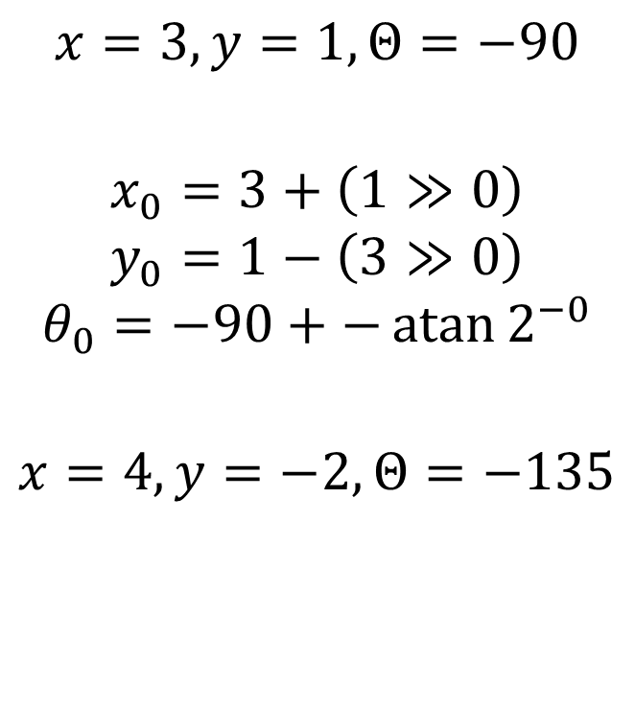
Example: Finding the Phase I=0
Iteration 0
Y is positive
Rotate “Down”
$$x=3, y=1, Θ=−90$$
$$x_{0}=3+\left(1≫0\right)$$
$$y_{0}=1−\left(3≫0\right)$$
$$θ_{0}=−90+−\operatorname{atan}{2^{−0}}$$
$$x=4, y=−2, Θ=−135$$

Slide 27
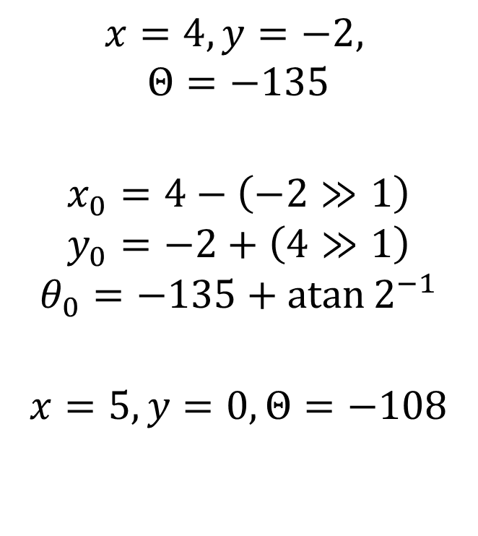
Example: Finding the Phase I=1
Iteration 1
Y is negative
Rotate “Up”
$$x=4, y=−2,$$
$$Θ=−135$$
$$x_{0}=4−\left(−2≫1\right)$$
$$y_{0}=−2+\left(4≫1\right)$$
$$θ_{0}=−135+\operatorname{atan}{2^{−1}}$$
$$x=5, y=0, Θ=−108$$

Slide 28

Example: Finding the Phase I=2
Iteration 2
Y is zero
We are done!
$θ=−Θ=108$
Actual answer?
$$atan(−1,3)$$
$$x=5, y=0,$$
$$Θ=−108$$

Slide 29

Example: Finding the Magnitude
Apply the $\frac{1}{\sqrt{1+2^{−2i}}}$ compensations now
5$\frac{1}{\sqrt{1+2^{−0}}}\frac{1}{\sqrt{1+2^{−2}}}=\sqrt{1^{2}+3^{2}}≈3.1622…$

Slide 30
Am I lucky or what?!
The example terminated nicely
Do all start vectors terminate?
Do all start vectors converge?
Explore the sequence $\operatorname{atan}{2^{−i}}$
How is it shaped?

Slide 31
The Point?
Area increases linearly per bit of accuracy
Cheap Hardware
Very reusable

Slide 32
With Remaining Time
Play with CORDIC
What other functions can it calculate?
Continue with practice from before
Start HW3

