Slide 1
ENGR xD52 Computer Architecture
Fall 2012

Slide 2
Hi, I’m Eric
VanWyk, Class of ’07

Slide 3
vanweric@gmail.com
Email and IM.
If I am online, you can bother me.

Slide 4
MH 361
Rarely… IM/Email me first.

Slide 5
Monday & Thursday 1330-1510 1520-1700

Slide 6
http://ca.olin.edu ca@lists.olin.edu
Feel free to use for discussion!

Slide 7
Course Objectives

Slide 8
Learn Digital Logic

Slide 9
Learn Digital Math

Slide 10
Build a Processor

Slide 11
Write Programs for it
In assembly

Slide 12
Build complex digital systems
In Verilog

Slide 13
Compare and Choose the right tools for the right jobs.
And sound smaht doing it.

Slide 14
Get Hired by National Instruments
And build really cool stuff with us in Austin, Surrounded-by-Texas-but-not-actually-in-Texas

Slide 15
You will intern with us
And you will like it.

Slide 16
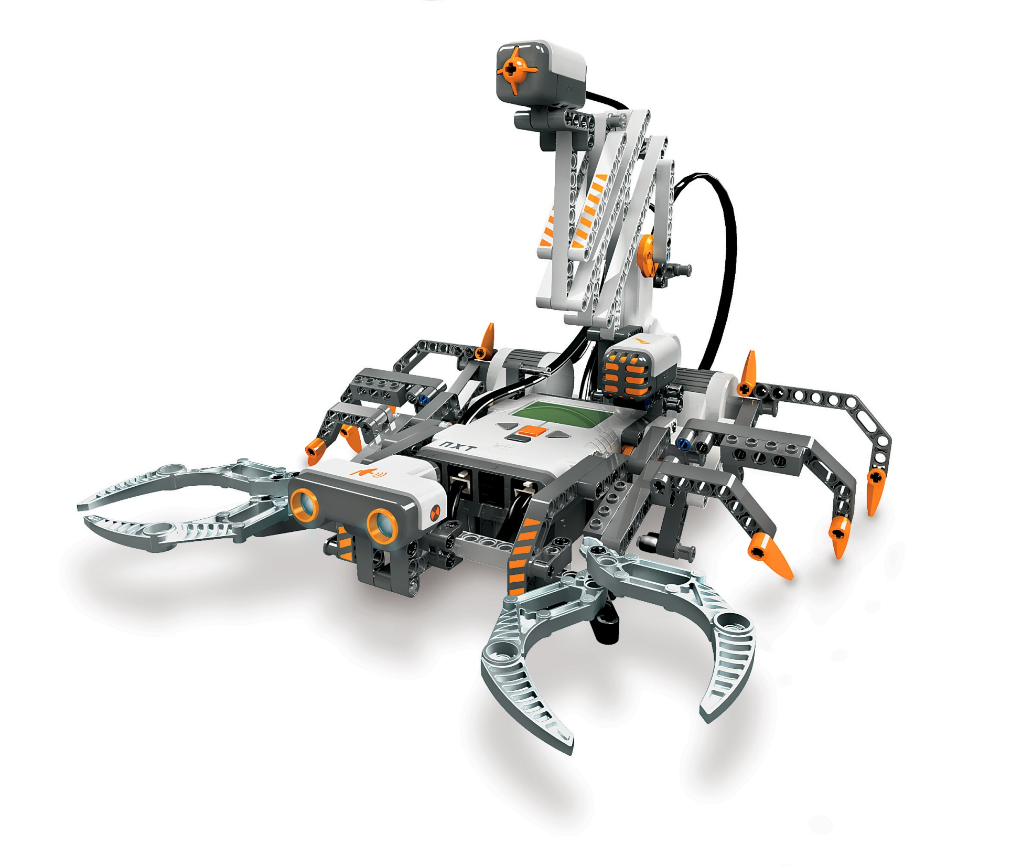

Slide 17
Course Details

Slide 18
One Midterm
No Final

Slide 19
Several Homeworks
Done individually.
Annotate collaboration per problem.

Slide 20
Several Labs
Done in groups of 2 or 3

Slide 21
One Awesome Project
Done in groups of ???

Slide 22
Late Policy:
-10% for first 24 hours
-20% for second (30% total)
-30% for third (60% total)
After 72 hours, no credit.

Slide 23
Attendance Policy:
At your own risk.

Slide 24
Homework for Tuesday
Register on the Wiki
http://ca.olin.edu
Buy the Book
Patterson, Hennessy, Computer Organization and Design: The Hardware/Software Interface, Fourth Edition, Morgan Kaufmann
http://alturl.com/oydvi

Slide 25
Homework for Tuesday
Answer these question:
Why are you taking this class?
What is your favorite processor? Why?
Name at least 3 things you want to learn in this class: Be specific!
What do you want to do with what you learn here after graduation? Prognosticate!
Email them to CompArch2012@gmail.com

