Slide 1
b0110 Fabric and Trust
ENGR xD52
Eric VanWyk
Fall 2012

Slide 2
Acknowlegements
ARM Holdings: M3 Cortex Instruction Set
Addison Wesley Longman: Figures
Wikipedia: Figures

Slide 3
Today
Decoders , Muxes, LUTs, Oh My
CPLDs and FPGAs
Do a Barrel Roll
Trust Issues
Preparation for your first Lab

Slide 4
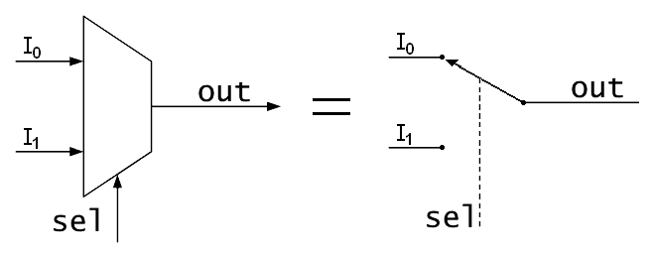
Muxes, AKA Multiplexor
Select or switch between inputs
Has one output, two types of inputs
‘Input’
‘Select’
#‘Select’ >= log2(# ‘Input’)
8 inputs needs 3 select (address) bits
Notes:
Figure Credit: Wikipedia

Slide 5
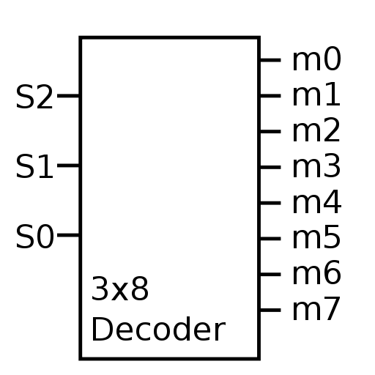
(Binary) Decoder
Also called a ‘demux’
Because it is the exact opposite.
Only one output is active at once
Usually has 2^inputs number of outputs
Sometimes has an enable input
Notes:
Figure Credit: Wikipedia

Slide 6
Look Up Tables
A form of Read Only Memory
Defined by Width and Depth
Width = How many bits per word
Depth = How many words available
Constructed as Muxes with constant inputs
Use Select to look up the table entry

Slide 7
Fabric Design
FPGA ‘Fabric’ is a sea of reconfigurable logic blocks embedded in reconfigurable routing logic.
The reconfigurable logic used to be mostly look up tables with configurable constants.
Now it is LUTs + other stuff too

Slide 8
Fabric Design
Design a small piece of an FPGA using:
Shift Registers
Decoders
Muxes
Other Stuff
Use your FPGA cell to create:
AND
XOR
Adder (Half? Full?)
Start by figuring out your requirements:
Width? Depth?

Slide 9
Do a Barrel Roll
We can multiply or divide a number by 2 by moving it left or right one position
This is called a “shift”
Don’t confuse it with a shift register!

Slide 10
Do a Barrel Roll
“Arithmetic” shifts obey 2’s complement
Sign extension
“Logical” shifts do not
Assume unsigned
Pad zeros
Barrel Rotate “wraps” around

Slide 11
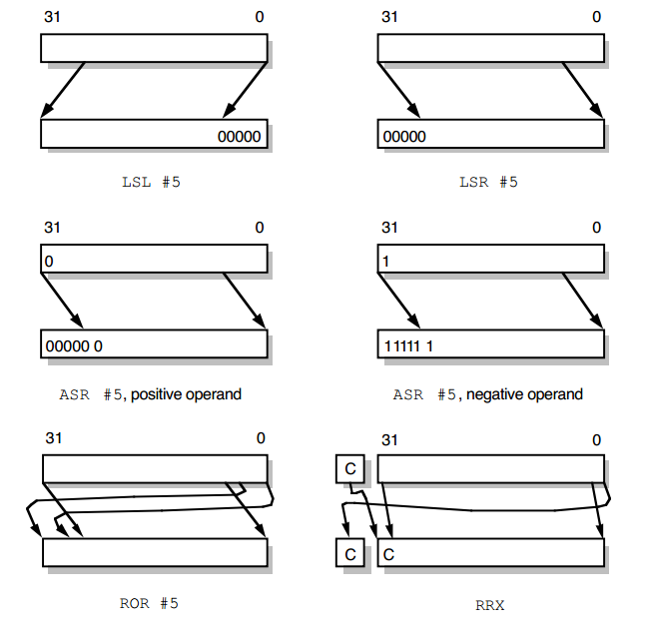
http://bwrc.eecs.berkeley.edu/research/pico_radio/Test_Bed/Hardware/Documentation/ARM/chap3.pdf

Slide 12
What could possibly go wrong?
You have been given a magic barrel shifter
Sweet.
List possible ways it could be busted
Specific errors in the design of the component
Come up with a test plan for your shifter
How can you achieve full coverage without exhaustion?
Bonus: How would you construct this shifter?

Slide 13
Lab Preparation
Select 1 or 2 partners
Read through MP0.pdf
Questions?
Begin paper&pencil sketching of modules
You have the rest of class to begin work

