Slide 1
b0101 Time for Time
ENGR xD52
Eric VanWyk
Fall 2012

Slide 2
Acknowledgements
Mark L. Chang lecture notes for Computer Architecture (Olin ENGR3410)
Patterson & Hennessy: Book & Lecture Notes
Patterson’s 1997 course notes (U.C. Berkeley CS 152, 1997)
Tom Fountain 2000 course notes (Stanford EE182)
Michael Wahl 2000 lecture notes (U. of Siegen CS 3339)
Ben Dugan 2001 lecture notes (UW-CSE 378)
Professor Scott Hauck lecture notes (UW EE 471)
Mark L. Chang lecture notes for Digital Logic (NWU B01)
Texas Instruments Data Sheets

Slide 3
Today
Review Approximation Hacks from Yesterday
The ravages of time
Latches, Flip Flops, Sandals

Slide 4
Its Log
From lecture b0010:
1 R=r^n = n R=r digits
1 R_{A} Digit is ‘worth’ log_{RB}R_{A}
Hex: R_{A} = 16, R_{B} = 2
log₂ (16) = 4
1 Hex digit is ‘worth’ 4 binary digits

Slide 5
Its Log
24 binary digits ≈ 7 decimal digits
log₁₀(2) * 24 ≈ 7.2247198…
log₁₀(2)≈ 0.3 log₂(10)≈ 3.3
2^ ± 126 ≈ +/-10^ ± 38
126 * .3 ≈ 37.929…
How many digits does 2^24 have in decimal?

Slide 6
Combinational Logic Design Process
Understand the Problem
what is the circuit supposed to do?
write down inputs (data, control) and outputs
draw block diagram or other picture
Formulate the Problem in terms of a truth table or other suitable design representation
truth table, Boolean algebra, etc.
Choose Implementation Target
PAL, PLA, Mux, Decoder, Discrete Gates
Follow Implementation Procedure
K-maps, Boolean algebra, algorithmic simplification

Slide 7
Combinational vs. Sequential Logic
X
Z
Network implemented from logic gates.
The presence of feedback
distinguishes between sequential
and combinational networks.
1
1
X
Logic
Z
2
2
-
-
-
Network
-
X
-
-
Z
n
m
Combinational logic
no feedback among inputs and outputs
outputs are a pure function of the inputs
e.g., seat belt light:
(Dbelt, Pbelt, Passenger) mapped into (Light)
Driver_belt
Logic Circuit
Passenger_belt
Seat Belt Light
Passenger

Slide 8
Circuit Timing Behavior
Simple model: gates react after fixed delay
A
D
E
B
C
F
A
B
C
D
E
F
0
1
1
0

Slide 9
Circuit Timing Behavior
Simple model: gates react after fixed delay
A
D
E
B
C
F
A
B
C
D
E
F
0
1
1
0

Slide 10
Hazards/Glitches
Circuit can temporarily go to incorrect states
Copilot Autopilot Request
B
A
Pilot in Charge?
Autopilot Engaged
Pilot Autopilot Request
C
CAR
PIC
PAR
A
B
C
AE
Must filter out temporary states

Slide 11
Safe Sequential Circuits
Clocked elements on feedback, perhaps outputs
Clock signal synchronizes operation
Clocked elements hide glitches/hazards
X
Z
1
1
X
Logic
Z
2
2
-
-
-
Network
-
X
-
-
Z
n
m
Clock
Clock
Data
Compute
Valid
Compute
Valid
Compute

Slide 12
A what-ed wholement?
Clocked or Enabled Elements
Flip Flops and Latches
“Hold on” to state until triggered to update.
Many kinds

Slide 13
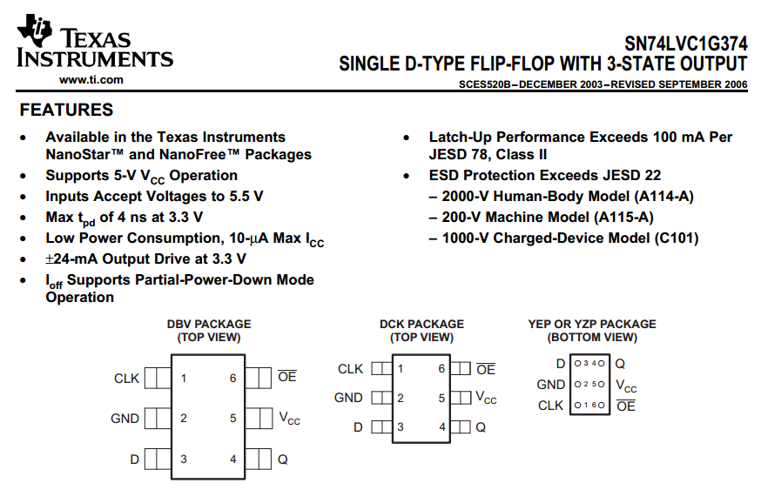
http://www.ti.com/lit/ds/symlink/sn74lvc1g374.pdf

Slide 14
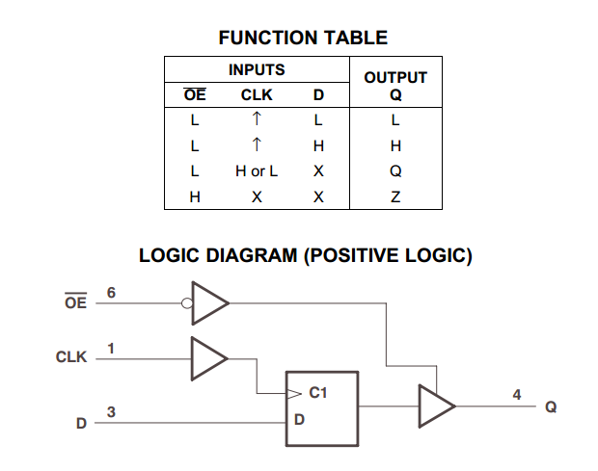
http://www.ti.com/lit/ds/symlink/sn74lvc1g374.pdf

Slide 15
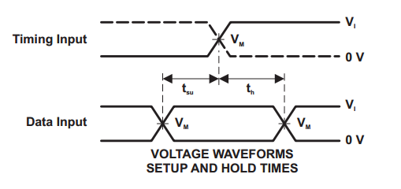
http://www.ti.com/lit/ds/symlink/sn74lvc1g374.pdf

Slide 16
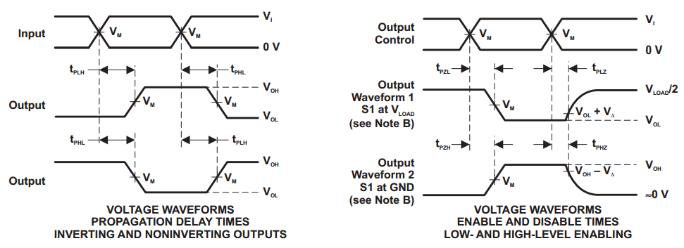
http://www.ti.com/lit/ds/symlink/sn74lvc1g374.pdf

Slide 17
Vocab!
Setup – Required stability before
Hold – Required stability after
Propagation Delay – Until outputs update

Slide 18
Reinventing the SR Latch
“SR” for “Set Reset”
Cross-coupled NOR/NAND
S | R | Q Next
0 | 0
0 | 1
1 | 0
1 | 1
http://en.wikipedia.org/wiki/File:R-S_mk2.gif

Slide 19
Reinventing the SR Latch
“SR” for “Set Reset”
Cross-coupled NOR/NAND
S | R | Q Next
0 | 0 | Q
0 | 1 | 0
1 | 0 | 1
1 | 1 | X
http://en.wikipedia.org/wiki/File:R-S_mk2.gif

Slide 20
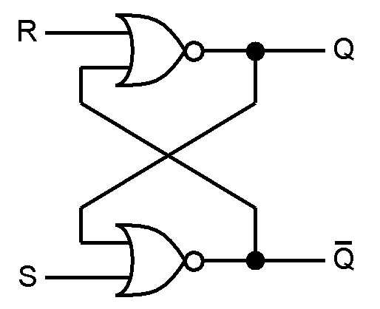
SR Latch Timing
S
R
Q
Q ̅

Slide 21
Design Time!
Invent new types of latches by adding control logic around a SR or S ̅R̅ latch
Treat the SR as a magic box
Create a truth table to translate your requirements to the SR’s inputs

Slide 22
Boreds
Gated SR latch
Inputs “work” only while Enable is True
When Enable is false, S/R have no effect
Design a Gated D Latch
One Data input instead of Set Reset.
Output follows input while enabled
When Enable is false, Output holds last value
Smallest design? Fastest? Weirdest?

Slide 23
You promised a Flop
Confusing vocab – they are similar
A latch is typically enabled
A Flip Flop is typically Clocked
All are forms of ‘Bistable Multivibrators’

Slide 24
Master Slave D-Flip Flop
Two D-Latches in series with opposite polarity Enable lines
Pulse Triggered
Capture on one edge
Display on the other
Basis of Shift Registers
“Bucket Brigade”

Slide 25
Edge Triggered D-Flip Flop
One Data Input
CLOCK input, not enable
Captures and Displays on the same edge
Constructed from 3 SR latches

Slide 26
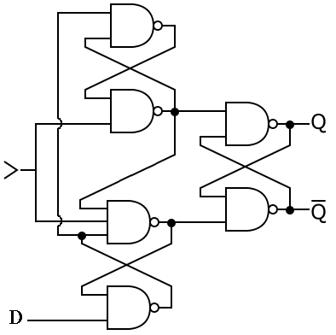
Edge Triggered D-Flip Flop

Slide 27
Other Flops
Ternary: Flip-Flap-Flop.
T Flip Flop
Toggles on each clock strobe
Good for cutting frequency in half
JK Flip Flop
Clocked SR flip flop that also supports toggling

Slide 28
Common Uses
In between processing stages
“Debounce” inputs
Hide external noise / uncertainty from the inputs
Synchronization

